Slide 1
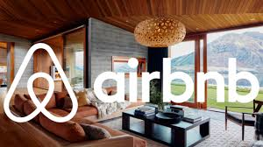

Slide 2
Introduction
The Airbnb is undergoing some of the unethical issues that their product is at risk for users that they should find a solution to the effects of cancellation policies to restore trust to its users.
Airbnb requires some of the best requirement to improve its operation.

Slide 3
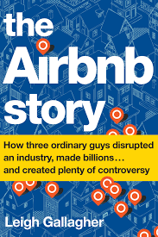

Slide 4
The Scramble of Airbnb to Restore “Trust Economy"
They should accept reservation requests, and this makes the guest feel welcome and attract many customers; as a result, they gain trust in their customers.
The company should resolve the cancellation policy since the customers still pay for a penalty when there are a cancellation and this benefit the company.

Slide 5
The Scramble of Airbnb to Restore “Trust Economy"
The company should apply flexible cancellation, which implies a full refund within 24 hours before the check-in times. This allows a full refund of the amount ant this is ethical as the company will be trusted for being honest and not exploiting the guests.
Airbnb should maintain a high overall rating to boost its economy. There has been a criticism of the company increasing prices that are exploiting the guests.

Slide 6
Ethical Theory
This knowledge of universalizability was introduced by Kant, it's the first part of the formulation of his own categorical imperative which says that the only accepted character maxims of our reaction are the one that can rationally be willed to the same rule
Activity is good and acceptable if everyone can be allowed to do it.

Slide 7
Ethical Theory
According to the author, such an illustration as a per formative contradiction since looking down upon the basis of their living.
The author's thinking of universalizability has an open relation to the opinion of the general will.
All these situations give a radical separation of will and nature leading to the opinion that true freedom sits substantially in self-legislation.

Slide 8
Conclusion
The Airbnb should utilize business ethics and provided customers satisfaction by not exploiting the guests in overcharging them. The company should not impose penalties on cancellation check-in by the customers and also improve on the marketing of the company by modifying the images to higher resolution and more attractive to increase the demand of the guests visiting the company and using their facilities

Slide 9
References
https://www.vice.com/en_us/article/43k7z3/nationwide-fake-host-scam-on-airbnb
https://www.wired.com/story/how-9-people-built-illegal-5m-airbnb-empire-new-york/
https://www.nytimes.com/2019/02/23/nyregion/airbnb-nyc-law.html
https://observer.com/2019/11/airbnb-scandals-trust-economy-2020-ipo/

